Slide 1



Data Accessibility
Rob Salguero-Gómez
@DRobcito

Slide 2
Colleagues/collaborators
Other researchers
Open(-ish) datasets online

Slide 3
Colleagues/collaborators
Your network of collaborators
Your advisors
Your advisors’ networks

Slide 4
Colleagues/collaborators
Your network of collaborators
Your advisors
Your advisors’ networks
How do you approach each of them?

Slide 5
Colleagues/collaborators
Your network of collaborators
Your advisors
Your advisors’ networks
How do you approach each of them?
What’s in it for them?

Slide 6
Other researchers
- Most journals are moving open-access/open-data

Slide 7
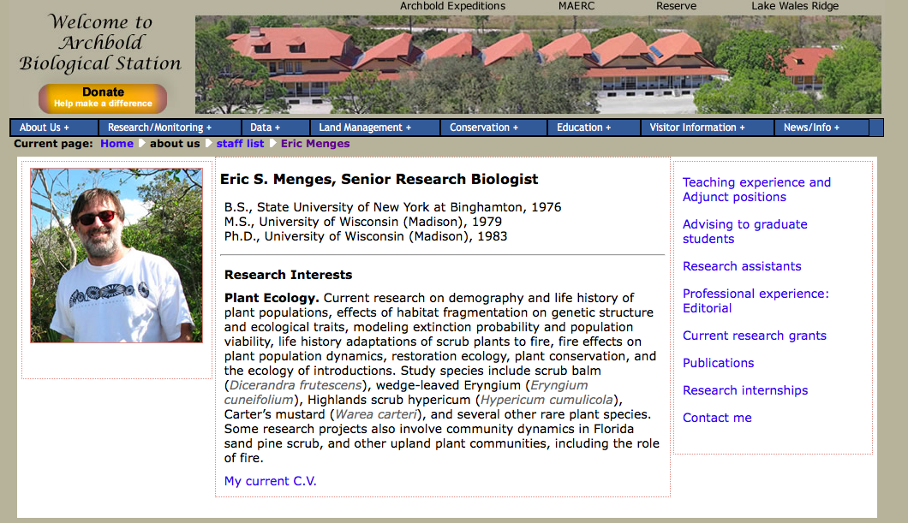
Other researchers
- Most journals are moving open-access/open-data
- Author’s website?

Slide 8
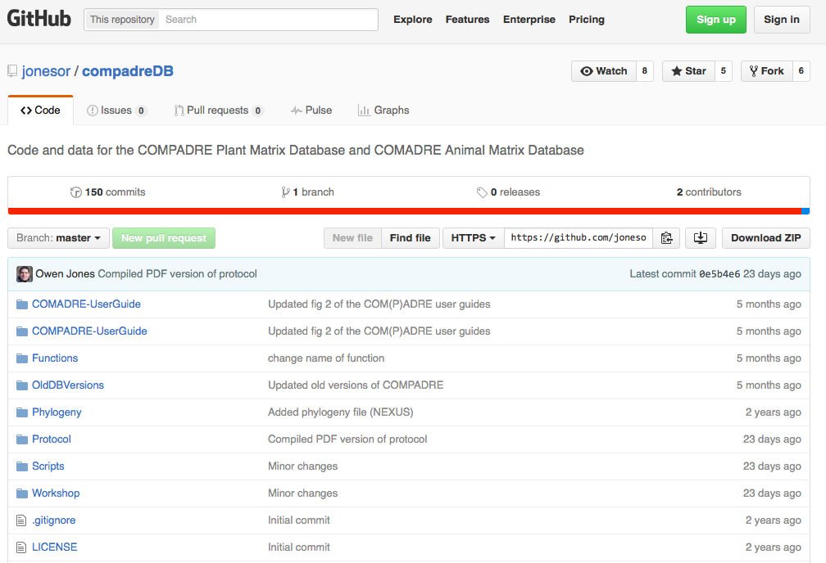
Other researchers
- Most journals are moving open-access/open-data
Author’s website?
Author’s github?

Slide 9
Other researchers
- Most journals are moving open-access/open-data
Author’s website?
Author’s github?
Dryad

Slide 10
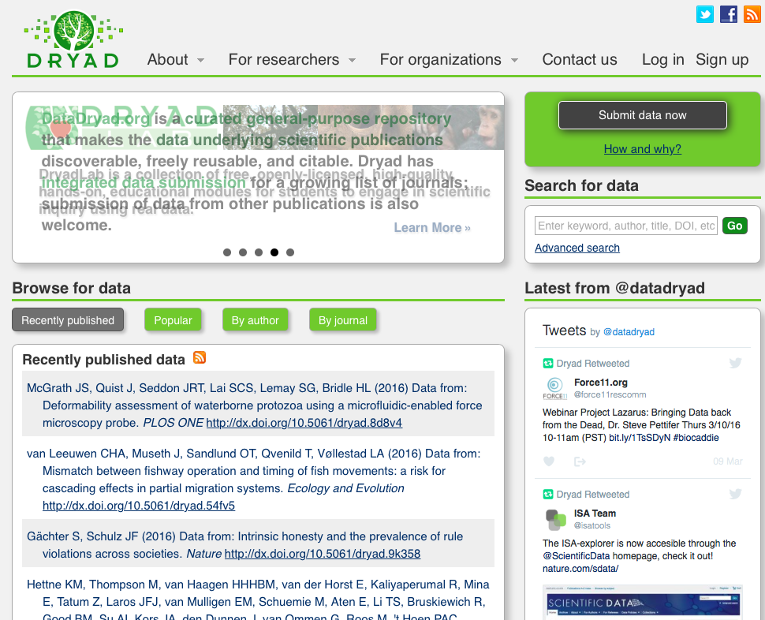
www.datadryad.org

Slide 11
Other researchers
- Most journals are moving open-access/open-data
Author’s website?
Author’s github?
Dryad
Ecological Archives and other journal repositories

Slide 12
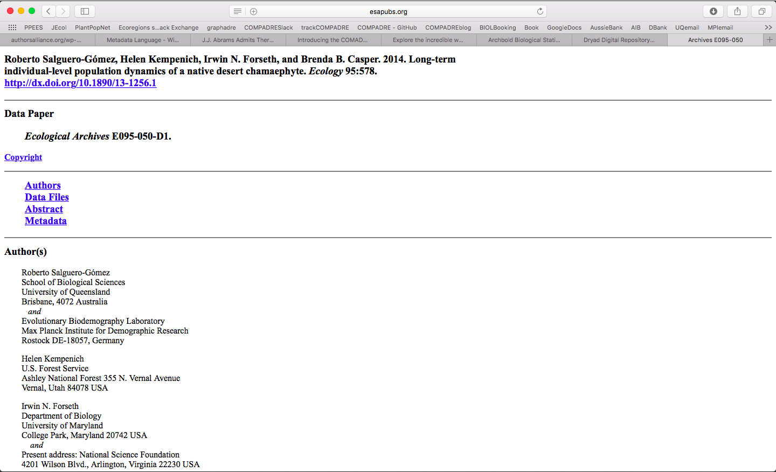
http://www.esapubs.org/archive/ecol/

Slide 13
Open-ish datasets online

Slide 14




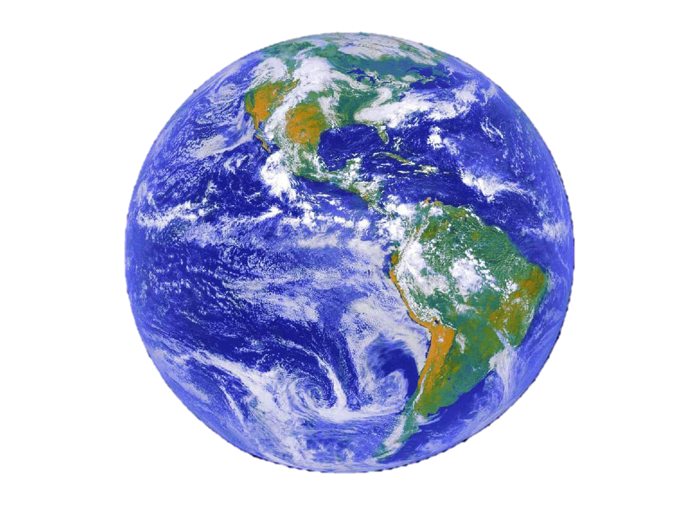



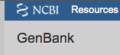






THE ERA OF BIG DATA, BIG SCIENCE is here!

Slide 15
Open-ish datasets online
Some databases have some restrictions on usage and authorship
How do I know which ones?
Read the help/small print/user agreements
https://creativecommons.org

Slide 16
